Slide 1
Multi-label image classifications For Fashion
Rahul Mahipati Bagal

Slide 2
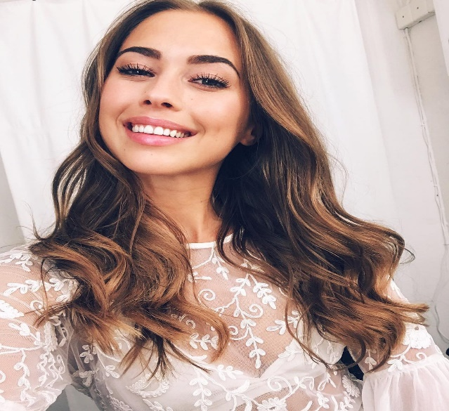
Objective
Multi-label fine grained image classification:
Develop an attribute classifier model for the Multi-label image classifications for the images that helps to labels the images uploaded by a different users
Example:
Product Type : Fabric print type
Blouses : Floral Print

Slide 3
Multi-label image classifications : Flow of the Process
Observations
Image Preprocessing
Model Building
Image Augmentations
Evaluate Model
Re-iterate, if Goal is not met

Slide 4

Initial Images observation and Assumptions
Initial Images with labels available for training : 42,990
Images to be labelled : 2,679
In the Training images set :
There are few duplicates images
Irrelevant images and no images files
The following are the labels groups for the images:
product_type : Blouses, Dresses and Skirts
fabric_print_type : Camouflage, check, floral print, leopard print, polka dot and stripe
Assumptions:
All images are labelled with precision and bounding boxes if there are available
We will use the wrongly labelled images just to add noise in the model as it’s occurrence is very less

Slide 5
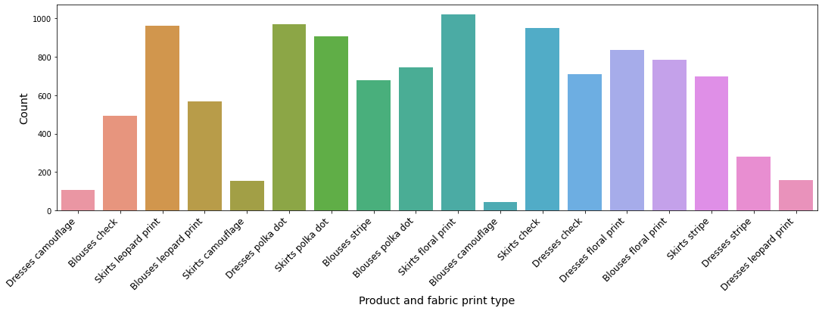
Preprocessing steps
Remove the duplicates images with the image hashing technique – “perception hashing“
After removing the duplicates, below is the occurrences of images w.r.t their labels.

Slide 6
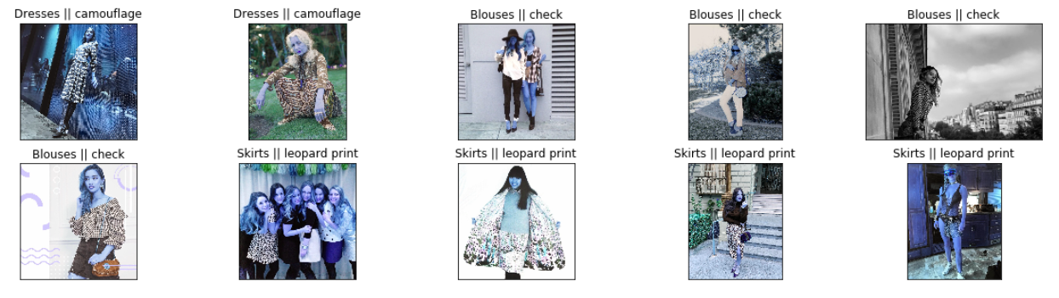
Image Samples

Slide 7
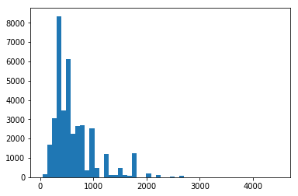
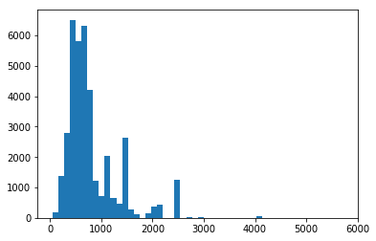
Preprocessing steps
After cropping the images that having bounding box, next step is to Identify the right image dimensions
Below are the frequencies of the height & width maximum values for all the images
As we have many high and few low dimensions images, we will reshape all the images to 250 x 250.
Frequency of the height
Frequency of the Width

Slide 8
Preprocessing Steps
The high dimensions and low dimensions images are processed separately as we have to preserve maximum information in the images
For low dimensions images:
Reshape using the “cv2.INTER_AREA” interpolation
For High dimensions images:
Reshape using the “cv2. INTER_CUBIC“ interpolation
For both the group of images after reshape we will use “cv2.bilateralFilter” Morphological operations to close gaps between objects as well as open them.

Slide 9
Handling the Imbalance Images Labels
We increase the frequency of images whose labels/categories have low occurrences / frequency. To achieve the aforementioned process (i.e balance data sets / up-sampling), we are applying the following image pre-processing operations
Rotation
Translation
Shear image
Flipping
Changing the brightness
Flipping
De-noise images using “GaussianBlur”
Images labels whose occurrence’s are high, we are selection random image pre-processing operations mentioned above
Note: we are taking random range values for most of the above operation’s input parameters respectively.

Slide 10

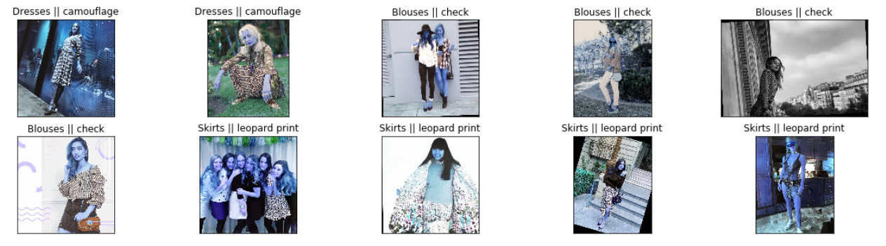
Convolution Neural Network Architecture – Custom Generator function
Custom Generator function :
We cannot use the default Generator inbuilt functionality of the Keras for an augmentations process, as the data set is imbalanced due to low occurrences of certain image labels. To balance / up-sample the data, image augmentation is required which cannot be achieved by default Keras Generator.

Slide 11
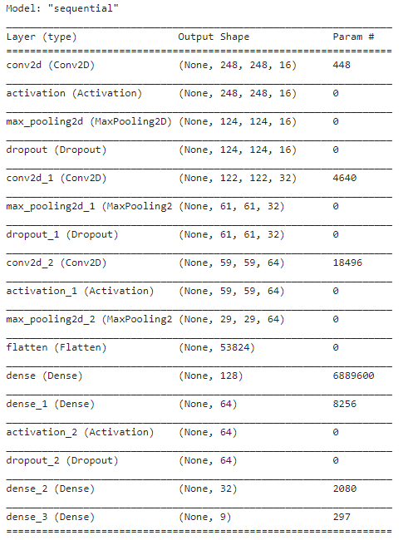
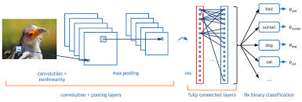
Convolution Neural Network Architecture
We are using Keras API (latest version of the TensorFlow v.2), Convolution neural network to build Multi-label image classifications. Below is the architecture.

Slide 12
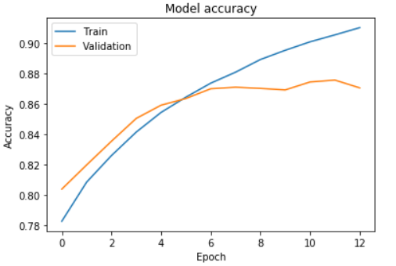
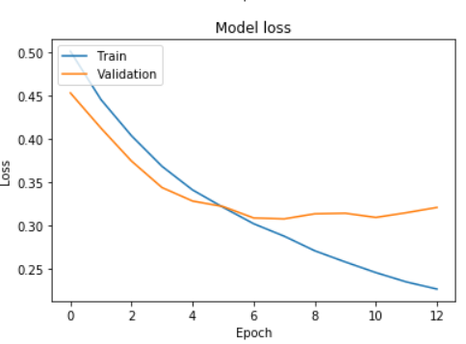
Model Validation and Metrics
In CNN, we are using the below methods
Adam optimizer
“binary_crossentropy” as loss function with sigmoid activation function
Below is the Model Performance matrices for the Test image data sets (~ 7500 samples)

Slide 13

What next…
Remove mislabelled images any of the following techniques:
Labelled the wrongly labelled the images and use them in the model
Semantic Segmentation with Deep Learning
Region-Based Semantic Segmentation
Fully Convolutional Network-Based Semantic Segmentation
Weakly Supervised Semantic Segmentation
Advanced optimizer like AdaMod
Mish and Swish Activation functions
Different CNN Architectures
Dilated-convolution Neural network
Convolutional Neural Networks Using Class Activation Maps
So on…

Slide 14


